Slide 1
COMP 3311 Database Management Systems
Lab 3. SQL aggregate
functions and sub-queries

Slide 2
Objectives of the Lab
After this lab you should be able to
use SQL string functions
use SQL number functions
use SQL date functions
use aggregate functions in SQL
use SQL sub-queries
2
2

Slide 3
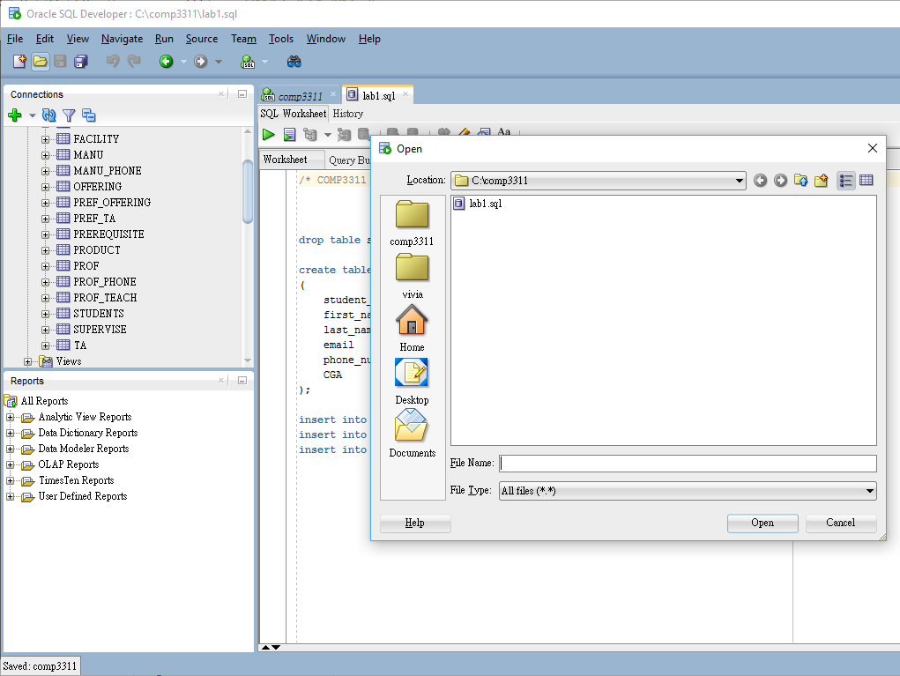
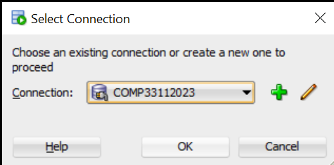
Downloading and running the lab SQL script file 1
Login Oracle database server using SQL Developer with your Oracle account
Download (save) the lab3.sql file to local file system
Open the file lab3.sql
Run the script
Choose connection
1
4
2
3
5

Slide 4
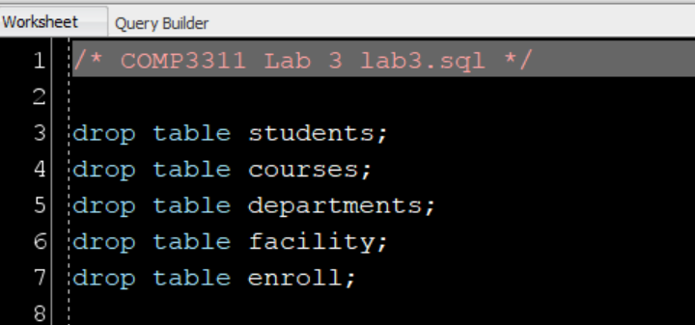
Downloading and running the lab SQL script file 2
The tables students and departments created last time were dropped.
5 new tables are created. They are
students,
courses,
enroll,
departments, and
facility.
The facility table indicates the number of projectors and computers each department has.

Slide 5
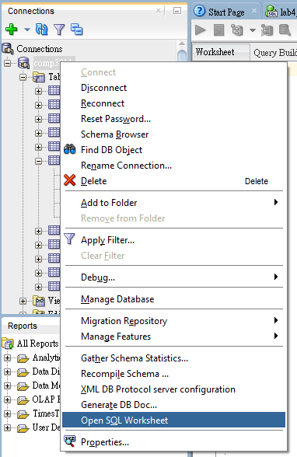
Run SQL statement
switch to worksheet or open new worksheet
type statements in worksheet
keep the cursor on this line and run statement
result will be shown in Query Result or Script Output
1
Right click to the database
2
Pull down the menu and select here

Slide 6
Snippets 1
Snippets are code fragments, such as SQL functions, Optimizer hints, and miscellaneous PL/SQL programming techniques.
Some snippets are just syntax, and others are examples.
You can insert and edit snippets when you are using the SQL Worksheet or creating or editing a PL/SQL function or procedure.

Slide 7
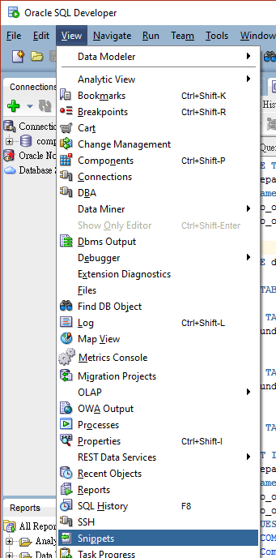
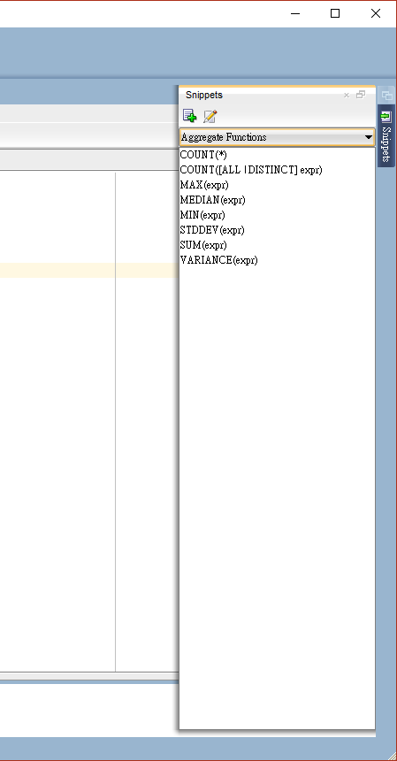
Snippets 2
1
Click the View menu, select Snippets.
In the snippets window (on the right side), use the drop-down to select a function group.
You can display and hidden the snippets window with Snippets button is placed in the right window margin
3
2

Slide 8
Snippets 3
To insert a snippet into your code
Drag the snippet from the snippets window and
Drop it into the desired place in your code; then
Edit the syntax so that the SQL function is valid in the current context.
To see a brief description of a SQL function in a tooltip, hold the pointer over the function name.

Slide 9
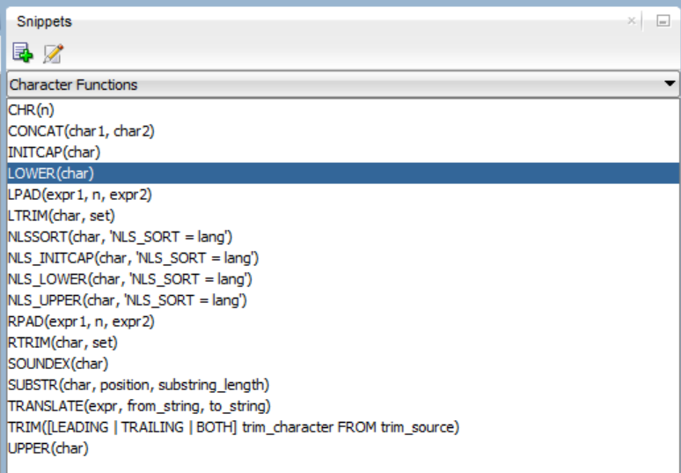
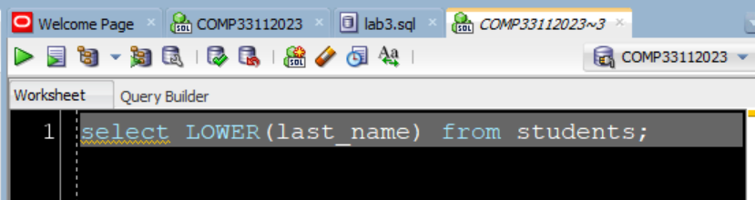
Snippets 4
1
For example, you could open a worksheet
type SELECT in the worksheet
use the snippet drop-down menu to select Character Functions
drag LOWER(char) in the worksheet
edit the LOWER function syntax as follows: char -> last_name
type the rest of the statement, for example: SELECT LOWER(last_name) FROM students;
2
Remember the semi-colon
3

Slide 10
SQL String functions 1
String functions take strings as input and give either strings or numerical values as output
Examples:
LOWER(string) – converts all the characters in the string to lowercase
SELECT LOWER(last_name) FROM students;
UPPER(string) -converts all the characters in the string to uppercase
SELECT UPPER(last_name) FROM students;
10
10

Slide 11
SQL String functions 2
INITCAP(string) – set the first character of each word to be in uppercase.
SELECT INITCAP(name) FROM courses;
e.g. bob->Bob
SUBSTR(string,position,length) – returns a particular portion of a string.
SELECT SUBSTR(first_name,2,3) FROM students;
e.g. Harry->arr
CONCAT(string1,string2) – concatenates two strings. “||” on the other hand can concatenate more than 2 strings.
SELECT CONCAT(last_name, first_name) FROM students;
SELECT last_name||first_name FROM students;
11
11

Slide 12
SQL String functions 3
INSTR(string1, length, string2) – returns the location of string2 in string1.
SELECT INSTR(last_name,'or') FROM students;
E.g. Porter-> 2, Da Vinci-> 0, null->null
LENGTH(string) – returns the length of a string.
SELECT LENGTH(last_name) FROM students;
E.g. Porter->6
LPAD(string1,length,string2) – pads string2 to the left of string1 so that the new string's length equals to length.
SELECT LPAD('a',10,'b') FROM students; e.g. bbbbbbbbbba
RPAD(string1,length,string2) – pads string2 to the right of string1 so that the new string's length equal to length.
SELECT RPAD('a',10,'b') FROM students; e.g. abbbbbbbbbb
12
12

Slide 13
SQL String functions 4
LTRIM(string) – removes all the left spaces from the string.
LTRIM(' a ') gives you 'a '
RTRIM -– removes all the right spaces from the string.
RTRIM(' a ') gives you ' a'
13
13

Slide 14
SQL numeric functions
These functions accept numeric inputs and output numeric values.
Examples
MOD(number1,number2) – returns number1 mod number2.
POWER(number1,number2) – returns (number1)^{number2}.
ROUND(number1, Integer_number2) - returns a value rounded to integer_number2 places.
TRUNC(number1, Integer_number2) – truncates number1 to integer_number2 decimal places.
14
14

Slide 15
SQL DATE functions 1
The default date format for Oracle is 'DD-MON-YY'. 7th of March 2014 is therefore ' 07-MAR-14'.
Given date format: TO_DATE('05-03-14', 'DD-MM-YY')
Examples
ADD_MONTHS(date, number) – adds “number” of months to the date.
SELECT ADD_MONTHS('07-MAR-14',2) FROM dual;
ADD_MONTH
---------
07-MAY-14
(dual is an Oracle built-in table for SQL queries that do not logically have table names)
15
15

Slide 16
SQL DATE functions 2
LAST_DAY(date) – returns the date of the last day in the month of the specified date
NEXT_DAY(date,weekday) – returns the date of first weekday that is later than date.
The possible values for weekday are
'SUNDAY', 'MONDAY', 'TUESDAY', 'WEDNESDAY', 'THURSDAY', 'FRIDAY', 'SATURDAY'
NEXT_DAY('05-MAR-14','SATURDAY') would return '08-MAR-14'
16
16

Slide 17
SQL DATE functions 3
TO_DATE(string, date_format_string)- convert the string to the corresponding date according to the date_format_string.
TO_DATE('11-MAR-14','DD-MON-YY')
TO_DATE('2014-03-23','YYYY-MM-DD')
TO_CHAR(date,format_mask) – convert a date to a string with respect to the format mask. The format masks can be
'YYYY' : 4-digit year
'MM' : 2-digit month
'MONTH' : 'JANUARY', 'FEBRUARY', etc
17
17

Slide 18
SQL aggregate functions 1
An aggregation function performs calculation on a collection of input data and returns a single value for the data.
ALL aggregate functions (except for count(*)) ignore NULL values (i.e. do not include them in the calculation)
Examples:
AVG (column) – returns the average value for the values in the column.
SELECT AVG(CGA) FROM students;
COUNT(column) – returns the number of records.
SELECT COUNT(CGA) FROM students;
18
18

Slide 19
SQL aggregate functions 2
Examples:
MAX (column) – returns the maximum value for the values in the column.
SELECT MAX(CGA) FROM students;
MIN(column) – returns the minimum value for the values in the column
SELECT MIN(CGA) FROM students;
STDDEV(column) – returns the sample standard deviation for the values in the column
SELECT STDDEV(CGA) FROM students;
SUM (column) – adds up all the values in the column
SELECT SUM(CGA) FROM students;
19
19

Slide 20
The GROUP BY clause
The GROUP BY clause groups the data by one or more columns, so that aggregate functions can be applied.
SELECT department_id, last_name AS LN FROM students GROUP BY department_id, last_name;
Note: 1. The non-aggregation attributes in the SELECT clause must be a subset of the attributes in the GROUP BY clause.
2. you can not use column alias in the GROUP BY clause Under Oracle, i.e. you can't change last_name to LN.
20
20

Slide 21
GROUP BY and the HAVING clause 1
The HAVING clause is applied to the GROUP BY clause to specify the condition(s) under which the results should be returned.
SELECT department_id, MAX(CGA) FROM STUDENTS GROUP BY department_id HAVING MAX(CGA)=12 or MAX(CGA)<10;
21
21

Slide 22
GROUP BY and the HAVING clause 2
The SQL statement can also contain the WHERE clause to specify the condition(s) for the records to be chosen, the chosen records will then be filtered by the condition(s) specified by the HAVING clause.
SELECT department_id, MAX(CGA) FROM
STUDENTS WHERE department_id='COMP'
GROUP BY department_id
HAVING MAX(CGA)=12 or MAX(CGA)<10;
22

Slide 23
Sub-query (1/3)
Example
students(student_id, first_name, last_name, CGA, department_id)
Sub-query in the WHERE clause works as part of the row selection process
Use a sub-query in the WHERE or HAVING clause when the criteria depends on the results of another table
SELECT first_name, department_id, CGA
FROM students
WHERE CGA = (
SELECT MIN(CGA)
FROM students
);
Do you know what this query does?
Sub-query
23
23

Slide 24
Sub-query (2/3)
Example
students(student_id, first_name, last_name, CGA, department_id)
Do you know what the following sub-query does?
SELECT department_id, AVG(CGA)
FROM students
GROUP BY department_id
HAVING AVG(CGA) >
(
SELECT AVG(CGA)
FROM students
);
Sub-query
COMP 3311 – Database Systems
24
24

Slide 25
Sub-query (3/3)
Example
students(student_id, first_name, last_name, CGA, department_id)
The following query utilizes two temporary tables to store the result of the sub-queries.
SELECT temp_table.department_id, temp_table.AVG_CGA
FROM (SELECT department_id,avg(CGA) AS AVG_CGA
FROM students
GROUP BY department_ID
) temp_table
WHERE temp_table.AVG_CGA >
( SELECT temp_cga.overall_avg_cga
FROM ( SELECT AVG(CGA) as overall_avg_cga
FROM students ) temp_cga );
25
Notes:
SELECT temp_table.department_id, temp_table.AVG_CGA FROM (SELECT department_id,avg(CGA) AS AVG_CGA FROM students GROUP BY department_ID) temp_table WHERE temp_table.AVG_CGA > (SELECT temp_cga.overall_avg_cga FROM (SELECT AVG(CGA) as overall_avg_cga FROM students ) temp_cga );

Slide 26
Example of Division Query
Find the first names of students who take all the courses:
select s.first_name
from students s
where not exists(
(select course_id from courses)
minus
(select course_id
from enroll e
where e.student_id=s.student_id));
COMP 3311 – Database Systems
26
26
Notes:
select s.first_name from students s where not exists ( (select course_id from courses) minus (select course_id from enroll e where e.student_id=s.student_id));

Slide 27
Conclusions
We covered the following topics in this lab:
Using Snippets in SQL Developer
SQL string functions, number functions and date functions
Aggregation functions in SQL
Illustrations of sub-queries
An example on division using SQL
27
27

Slide 28
Exercise
Write an SQL to check if there is a course being enrolled by all students. What is your answer?
28
28

